Slide 1
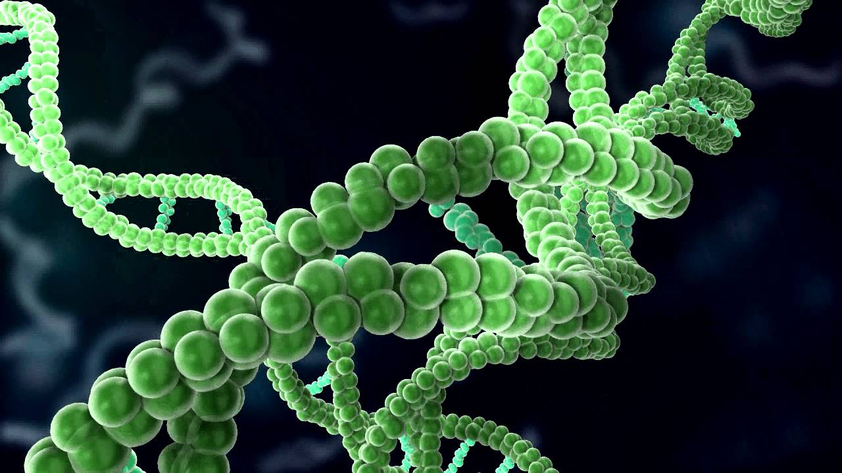
Specfic Technique of Gene Structure
By Mowliha.T.J

Slide 2
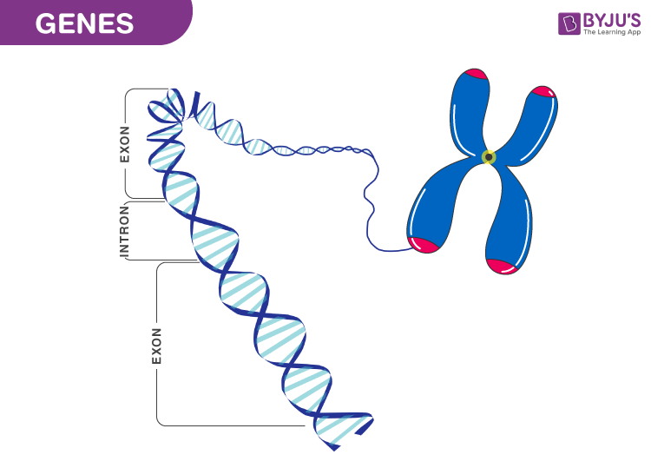
Genes are functional units of heredity as they are made of DNA.
The chromosome is made of DNA containing many genes.
Speaking in usual terms, genes are responsible for heredity

Slide 3
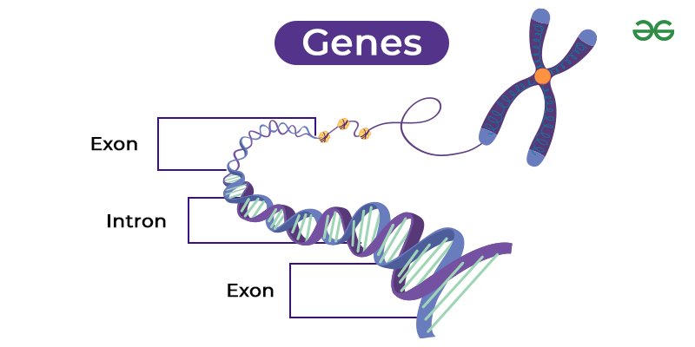
Classification of Gene Structure :

Slide 4
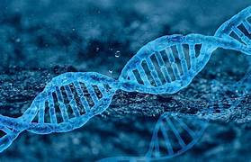
Functions of gene :
Genes control the functions of DNA and RNA.
These enzymes play an important role in conducting various chemical processes and reactions within the body.

Slide 5
Techniques in Gene Structure:
DNA Sequencing :
This technique determines the exact sequence of nucleotides (A, T, C, G) in a DNA segment, allowing researchers to identify the structure of genes, including exons, introns, and reUndgulatory elements.
Applications :
Food science:
DNA sequencing is used in criminal investigations for identity verification.
Agriculture:
erstanding the genetic basis of traits in crops and livestock for breeding programs.

Slide 6
RNA SEQUENCING:
RNA-seq analyzes the transcriptome, allowing researchers to study gene expression and identify exon-intron boundaries, alternative splicing events, and other aspects of gene structure.
Applications :
Food science :particularly in areas such as crop improvement, food safety, nutrition, and understanding the biology of food-related organisms.
Agriculture : Offering deep insights into the molecular mechanisms underlying plant and animal traits, improving crop and livestock management.

Slide 7
THANK YOU

